Slide 1
PRAGMA 14
11-12 (Tue-Wed), March, 2008
NCHC, NARL
National Museum of Natural Science

Slide 2
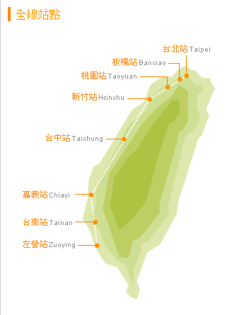

Taichung City
Tai-chung 台-中
Abbreviation Central City
Nickname Culture City
Area163.4256 km²
Population (August 2006)1,040,725 (http://en.wikipedia.org/wiki/Taichung#Museums_and_Cultural_Centers)
Industry:
  Tradition: Precision Machinery,
  Central Science Park: Optoelectronic,
  Semi-conductor, Biotech

Slide 3
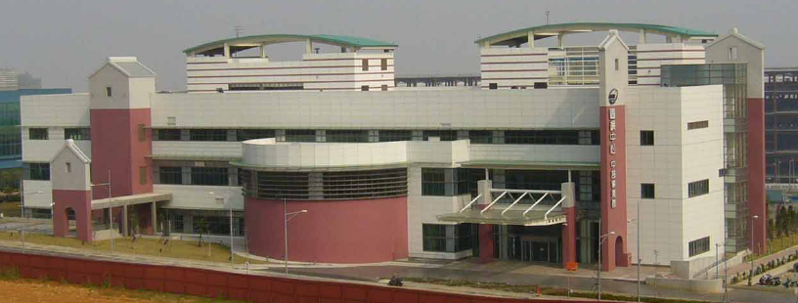
Venue:
Central Business Unit, NCHC @ Central Science Park
……….. Or NOT ?!

Slide 4
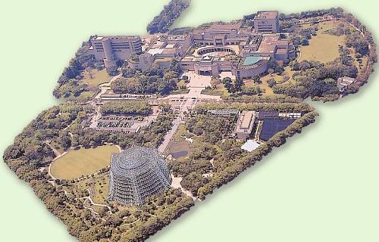
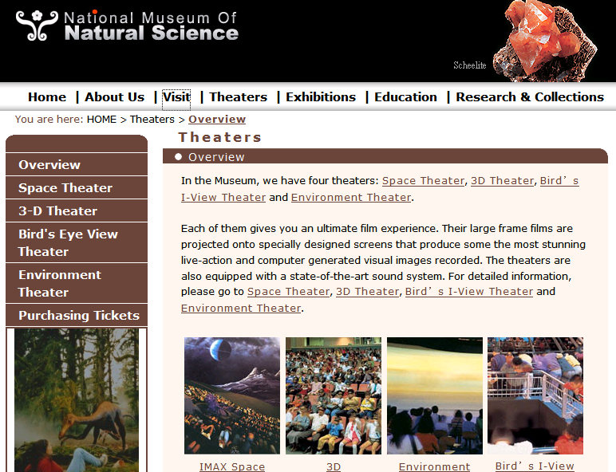
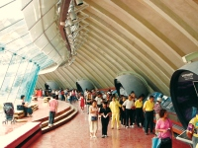
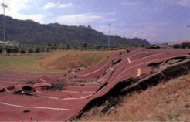
Venue:
  National Museum of Natural Science (NMNA)

Slide 5
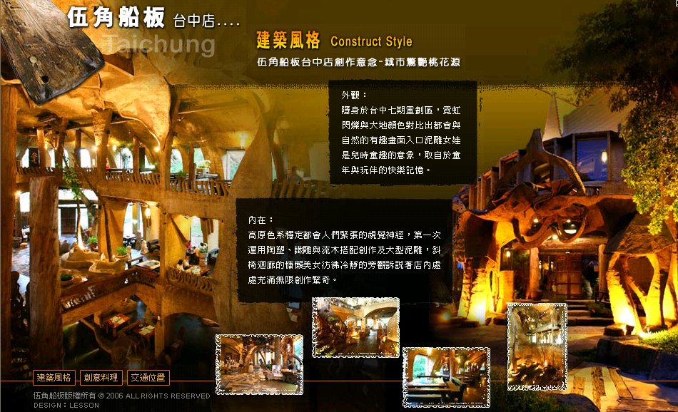
Where to eat …….

Slide 6
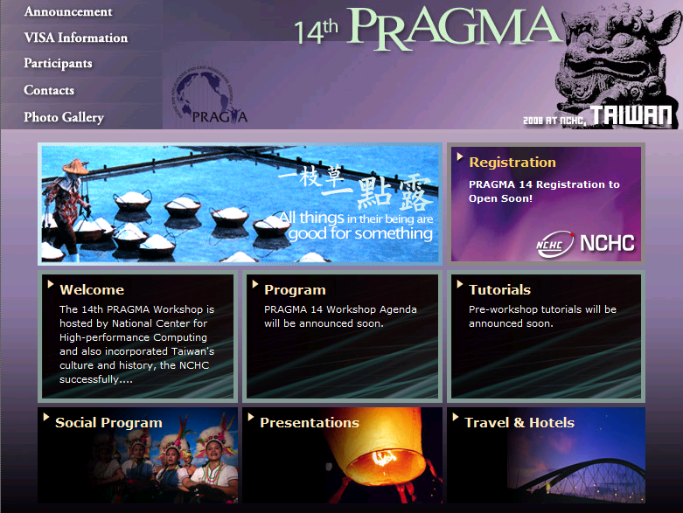

Slide 7
PRAGMA 14 Web Design:
Old Wisdom
一枝草, 一點露
One Grass, One Dew
All things in their being are good for Something
好酒沈甕底
Best taste of wine is always at the bottom of the wine Jar.
Better thing is yet to come….

Slide 8
See you all
in
PRAGMA 14
@ Taiwan !!

